Slide 1
علم الهائمات العملي بعض المعدات المستخدمة في علم الهائمات العملي

Slide 2
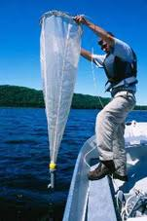
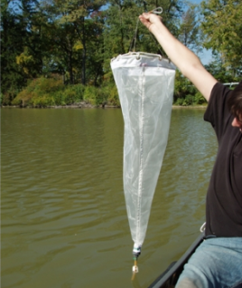
Plankton nets

Slide 3
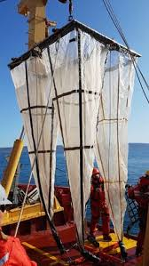
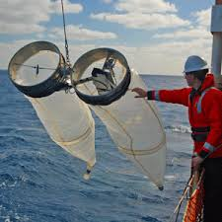
Plankton nets

Slide 4
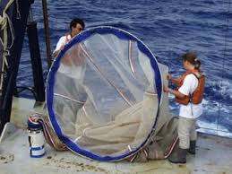
Plankton net

Slide 5
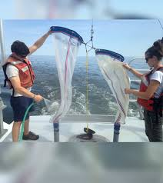
Plankton net

Slide 6
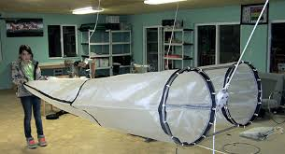
Plankton nets

Slide 7
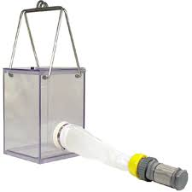
Shindler-Patalas trap

Slide 8
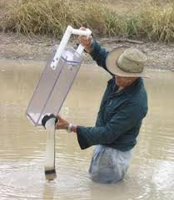
Shindler-Patalas trap

Slide 9
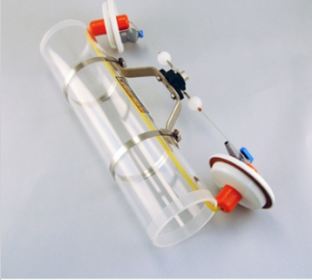
Van Dorn water sampler

Slide 10
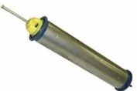
Kemmerer water sampler

Slide 11
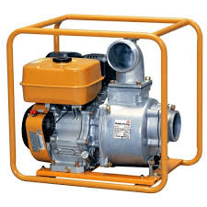
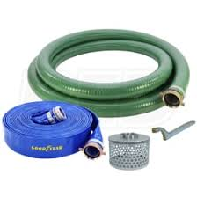
Water Pump

Slide 12
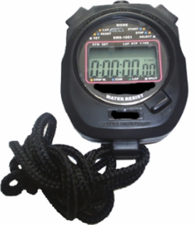
Time stop watch

Slide 13
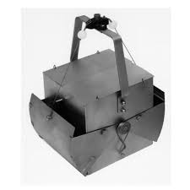
Ekman grap

Slide 14
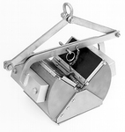
Petite Ponar grab

Slide 15
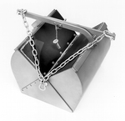
Van Veen grab

Slide 16
Van Veen grab

Slide 17
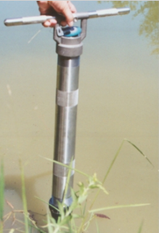
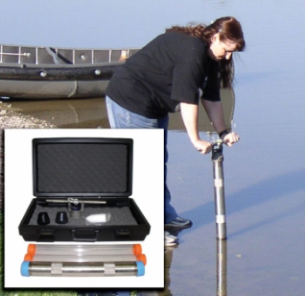
Hand Corer

Slide 18
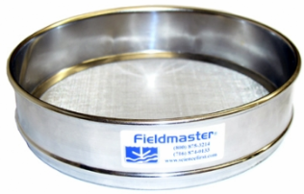
Metal Sieve

Slide 19
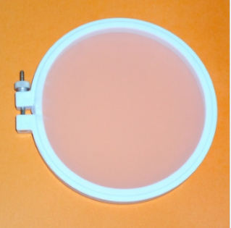
Plastic Sieve

Slide 20
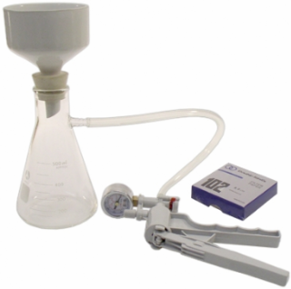
Filtration Unit

Slide 21
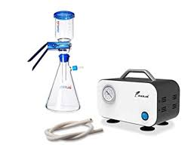
Filtration Unit

Slide 22
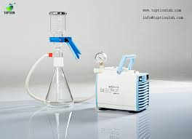
Filtration Unit

Slide 23
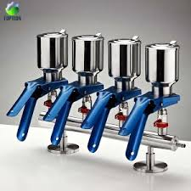
Filtration Unit

Slide 24
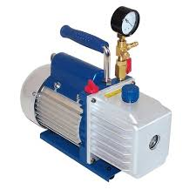
Vacuum

Slide 25
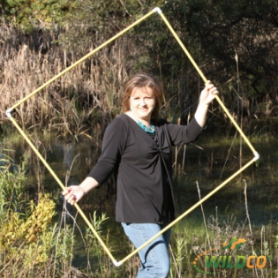
Quadrate

Slide 26
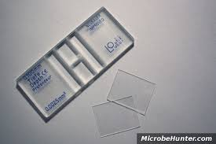
Hemocytometer

Slide 27
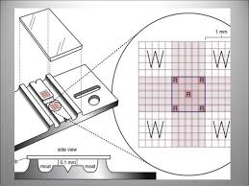
Hemocytometer

Slide 28
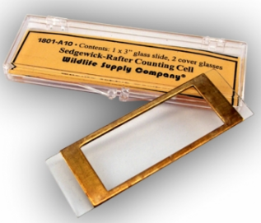
Sedgewick-Rafter counting cell

Slide 29
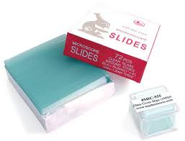
Slides + cover slips

Slide 30
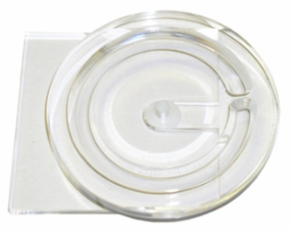
Ward zooplankton counting chamber

Slide 31
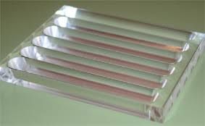
Bogorov zooplankton counting chamber

Slide 32
Bogorov zooplankton counting chamber

Slide 33
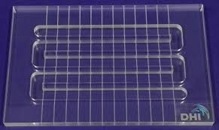
Bogorov zooplankton counting chamber

Slide 34
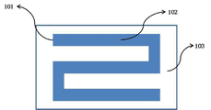
Bogorov zooplankton counting chamber

Slide 35
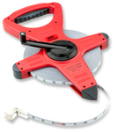
Measured tape

Slide 36
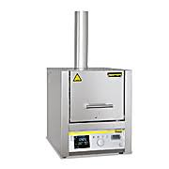
Ash Oven

Slide 37
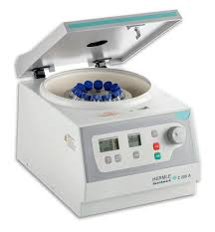
Centrifuge

Slide 38
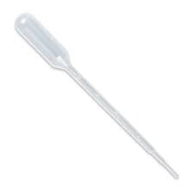
Disposable pipette

Slide 39
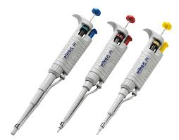
Micro pipettes

Slide 40
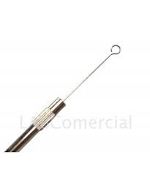
Loop

Slide 41
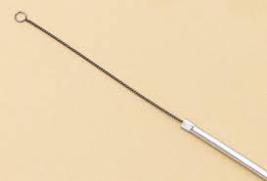
Loop

Slide 42
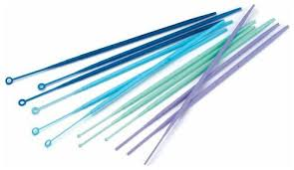
Loops

Slide 43
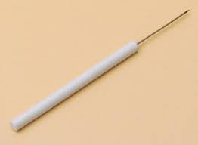
Needle

Slide 44
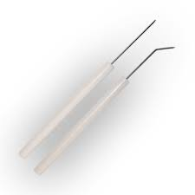
Needles

Slide 45
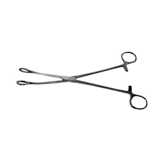
Forcep

Slide 46
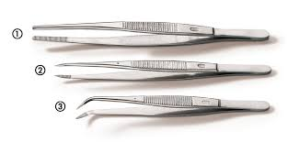
Forceps

Slide 47
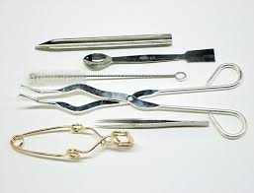
Forceps + loop + needle

Slide 48
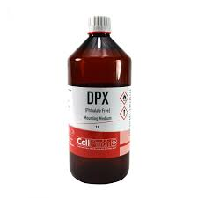
DPX

Slide 49
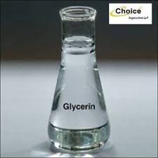
Glycerin

Slide 50
Compound Microscope

Slide 51
Dissecting Microscope

Slide 52
Progectina Microscope

Slide 53
Progectina Microscope

Slide 54
Ready glass slides

Slide 55
Ready glass slides

Slide 56
Hot Plate

Slide 57
Brushes

Slide 58
Conical Flask

Slide 59
Volumetric Flasks

Slide 60
Cylinders

Slide 61
Desiccator

Slide 62
Glass Beaker

Slide 63
Burettes

Slide 64
Test tube

Slide 65
Capillary tube

Slide 66
Glass pipettes

Slide 67
Petri dish

Slide 68
Glass Petri dishes

Slide 69
Divided Petri dishes

Slide 70
vials

Slide 71
vials

Slide 72
Thermometer

Slide 73
Digital Current Meter

Slide 74
Drying Oven

Slide 75
Spectrophotometer

Slide 76
Water Bath

Slide 77
Secchi disk

